Slide 1
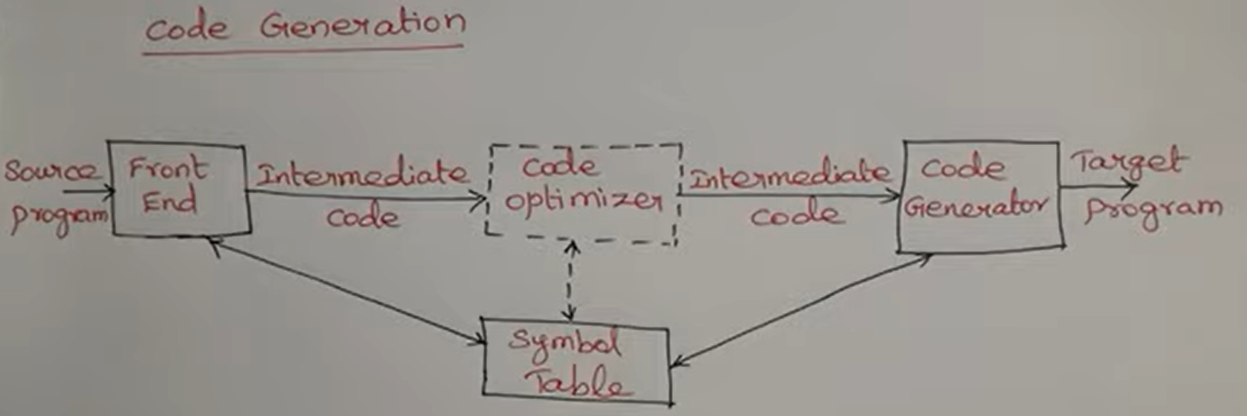

Slide 2
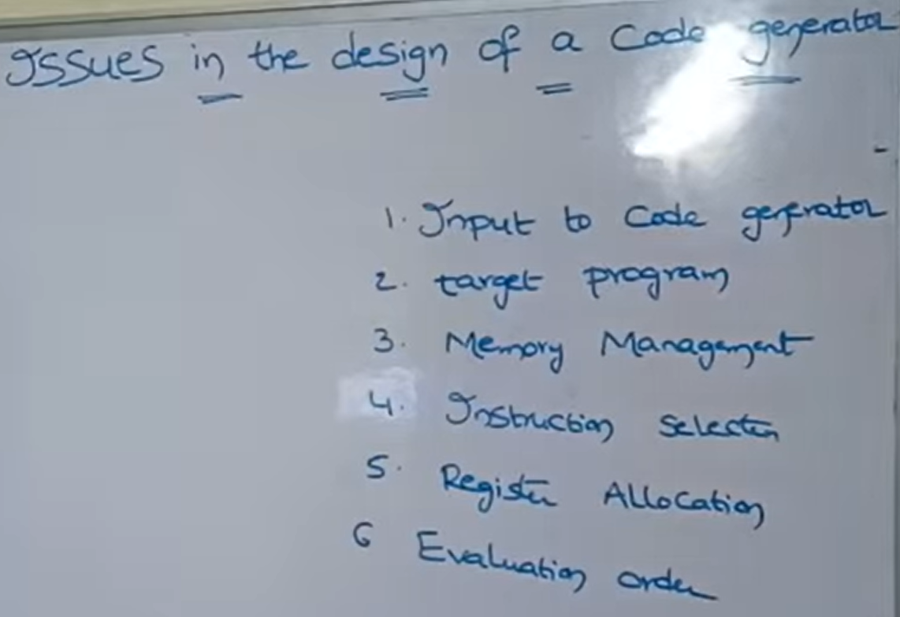
While designing the code generator we have to keep certain issues in our mind. We need to keep following issues in our mind.

Slide 3
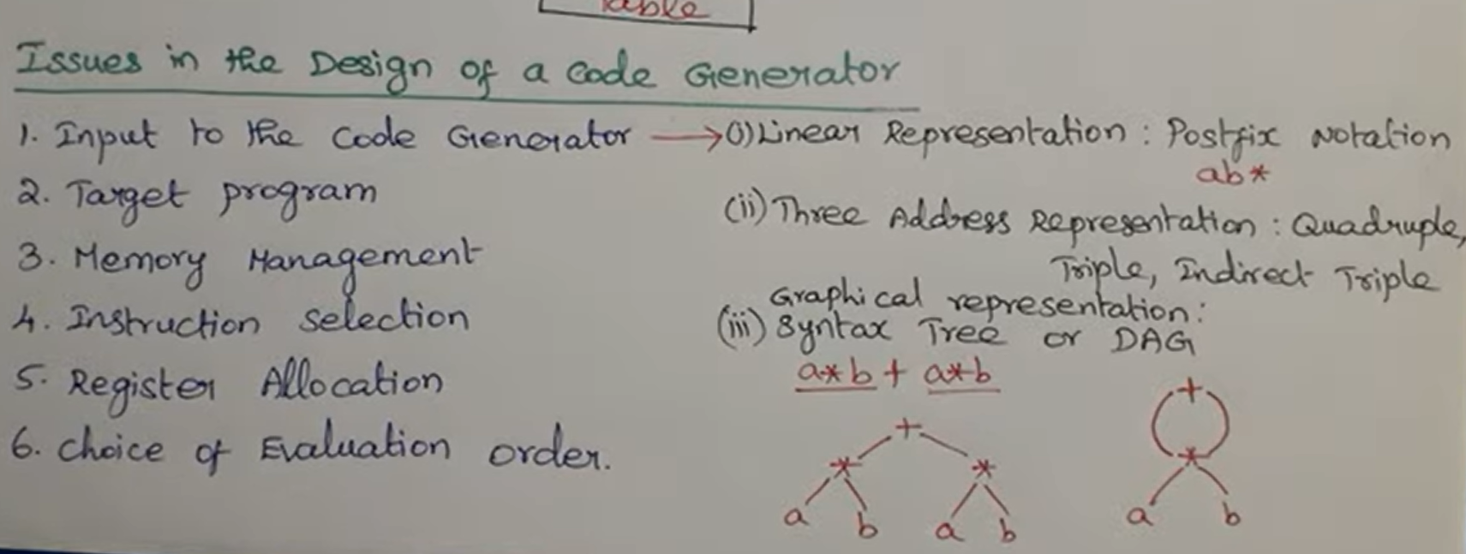
1. Input to the code generator - Code generator accepts intermediate code as input. These intermediate code is represented in these ways

Slide 4
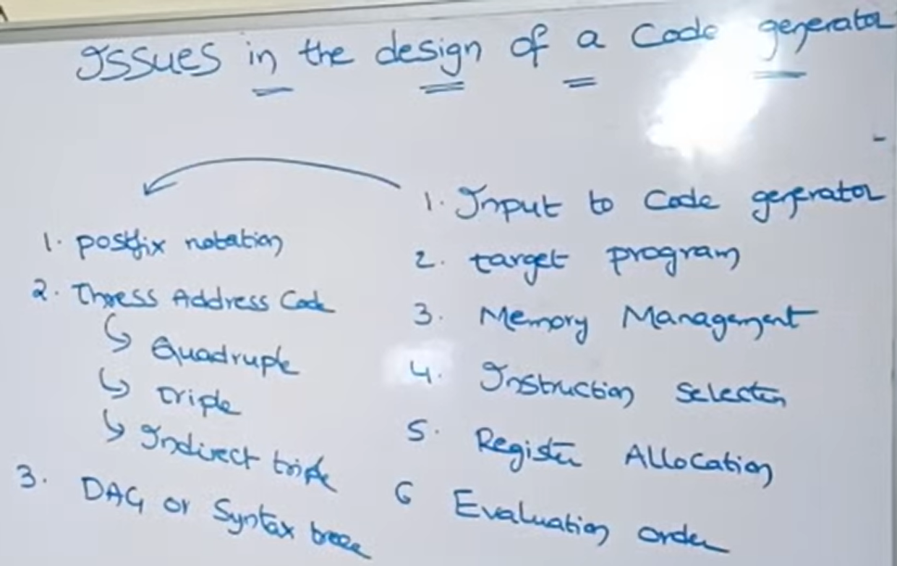

Slide 5

2. Target Program - Code generator accepts intermediate code and produces a Target program as output. It produces one of the three programs as output.
i. Absolute Machine Language – Absolute means fixed memory location of the RAM. That memory location will not change. It is mainly suitable when the program is very small, so that the program is compiled and executed in faster manner, since CPU is accessing it in a faster manner.

Slide 6
ii. Relocatable machine language - is said to be object code- created after compilation of a program. We need linker and loader for compilation.
Linker: Links the object code of several programs to a single program. Let the program contains several library functions resides in some header files like printf function - available in stdio.h. The Linker links object code of these library functions into a single pgm.
Loader: Then after that the loader loads the linked executable file into the main memory in any free space (relocatable). The relocatable m/c language suitable for small pgm and large program.
ii. Assembly Language: This is the better target program. Generates code in an easy manner.

Slide 7
3. Memory management: To manage the memory, symbol table is used. The program will be divide into tokens and the token information will be stored in the symbol table. So, with the help of the symbol table memory management is done

Slide 8
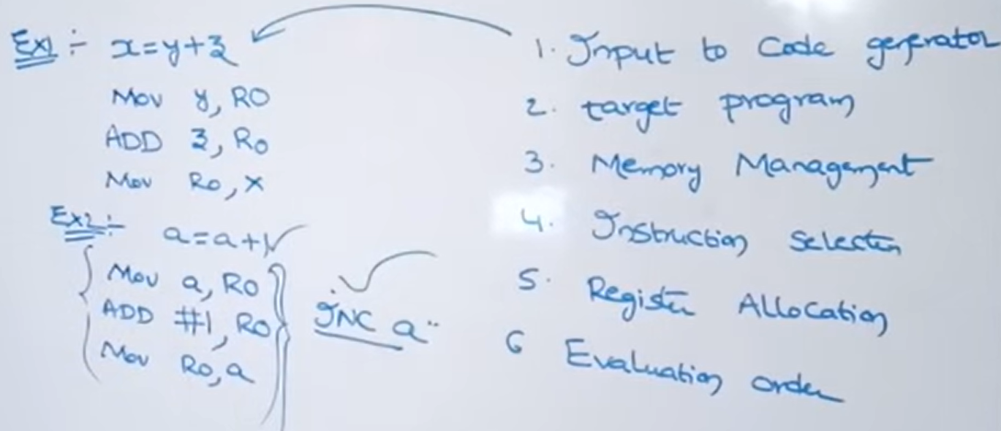
4. Instruction Selection – Instruction selection as well as the speed of the instruction is important for producing efficient target code.

Slide 9
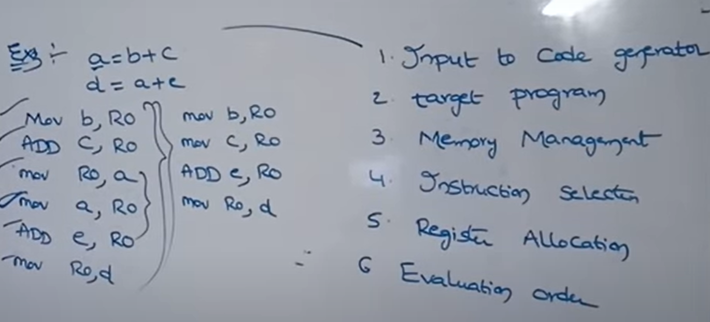

Slide 10
5. Register Allocation- suppose if we need to perform more number of instructions with limited number of register, with the help limited number of registers we need to perform more number of operations then only we will get efficient target code. This is done with the help of two ways
i. Register allocation – Specifies which register contains which variable
R0 contains a
R1 contains b
ii.Register Assignment – Specifies which variable contains which register
a contains R0
b contains R1

Slide 11
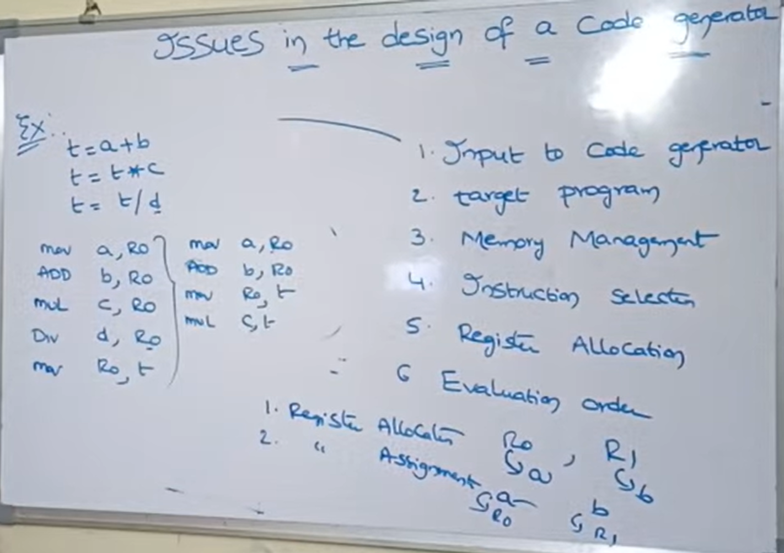

Slide 12
6. Evaluation Order – The order in which the instructions are executed and the operations are performed will decides the efficiency of the target code

